Slide 1
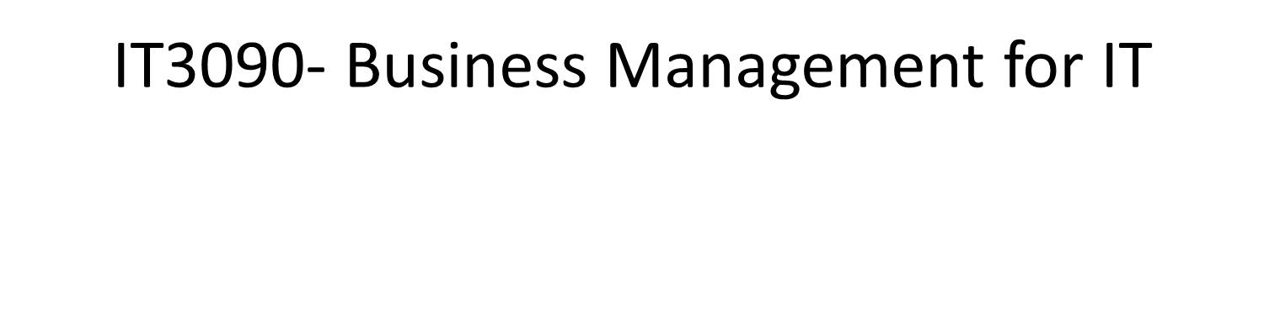
Lecture 04 (Part 1) – Economics
IT3090 - Business Management for IT- Lecture 04 - Ms. Nilmini Rathnayake

Slide 2
LEARNING OUTCOMES
At the end of the lecture, students should be able to;
Understand the basic economic concepts.
Explain the concept of demand and supply.
Identify the market structures and their characteristics.
IT3090 - Business Management for IT- Lecture 04 - Ms. Nilmini Rathnayake

Slide 3
Basic Economic Concepts.
IT3090 - Business Management for IT- Lecture 04 - Ms. Nilmini Rathnayake

Slide 4
Needs, Wants and Resources
Need – the basic desires of the humans
Want – the different ways of satisfying needs
Factors of Production or Types of resources
Land – The gifts of nature such as land, forests, minerals
Labour – All human resources whether inherited or acquired, and could be used in production
Capital – Man made aids to further production such as tools, machinery, factories
Entrepreneurship – People who take risks by introducing new products or new ways of old products
IT3090 - Business Management for IT- Lecture 04 - Ms. Nilmini Rathnayake

Slide 5
Scarcity of Resources
Society has insufficient productive resources to fulfill all human wants and needs
Unlimited human needs and wants, in a world of limited resources
Scarcity refers to the basic economic problem
This situation requires people to make decisions about how to allocate resources efficiently, in order to satisfy basic needs and wants.
IT3090 - Business Management for IT- Lecture 04 - Ms. Nilmini Rathnayake

Slide 6
Choice
Due to scarcity of resources, there is a choice.
Choice involves compromising between competing interests.
When people have to choose, they have to analyze the Costs and the Benefits of the choices which is known as Cost Benefit Analysis. An action should be taken if the benefits exceed its costs.
IT3090 - Business Management for IT- Lecture 04 - Ms. Nilmini Rathnayake

Slide 7
Basic economic questions
Since resources are limited (scarcity) and wants are unlimited, we must chose how to make optimum economic use of resources.
These choices that we make on a daily basis are attempts to solve the basic economic questions.
What to produce
Choice of goods or services
How to produce
Production method
For whom to produce
Target consumers
IT3090 - Business Management for IT- Lecture 04 - Ms. Nilmini Rathnayake

Slide 8
Opportunity Cost
The resources are scare and they have alternative uses.
The opportunity cost is the value of the next best alternative that must be forgone to undertake the activity.
IT3090 - Business Management for IT- Lecture 04 - Ms. Nilmini Rathnayake

Slide 9
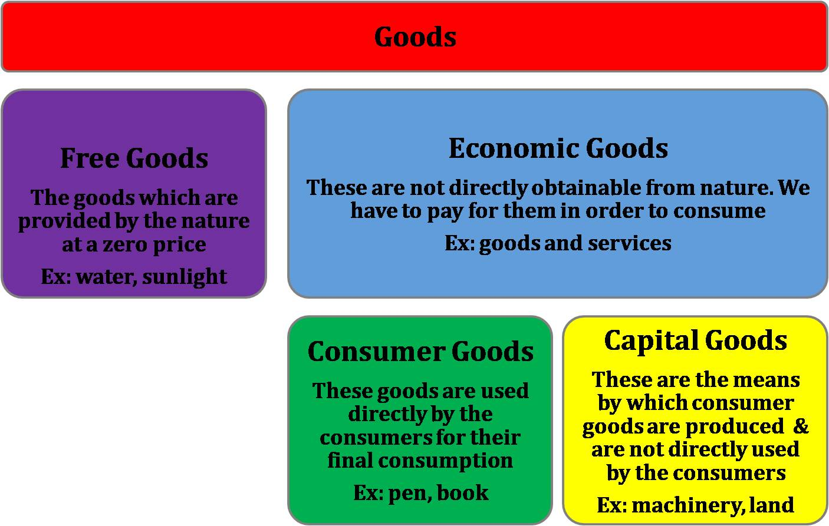
Types of goods
IT3090 - Business Management for IT- Lecture 04 - Ms. Nilmini Rathnayake

Slide 10
Economic Systems
Free Market economy
Planned/ Command Economy
Mixed Economy
IT3090 - Business Management for IT- Lecture 04 - Ms. Nilmini Rathnayake

Slide 11
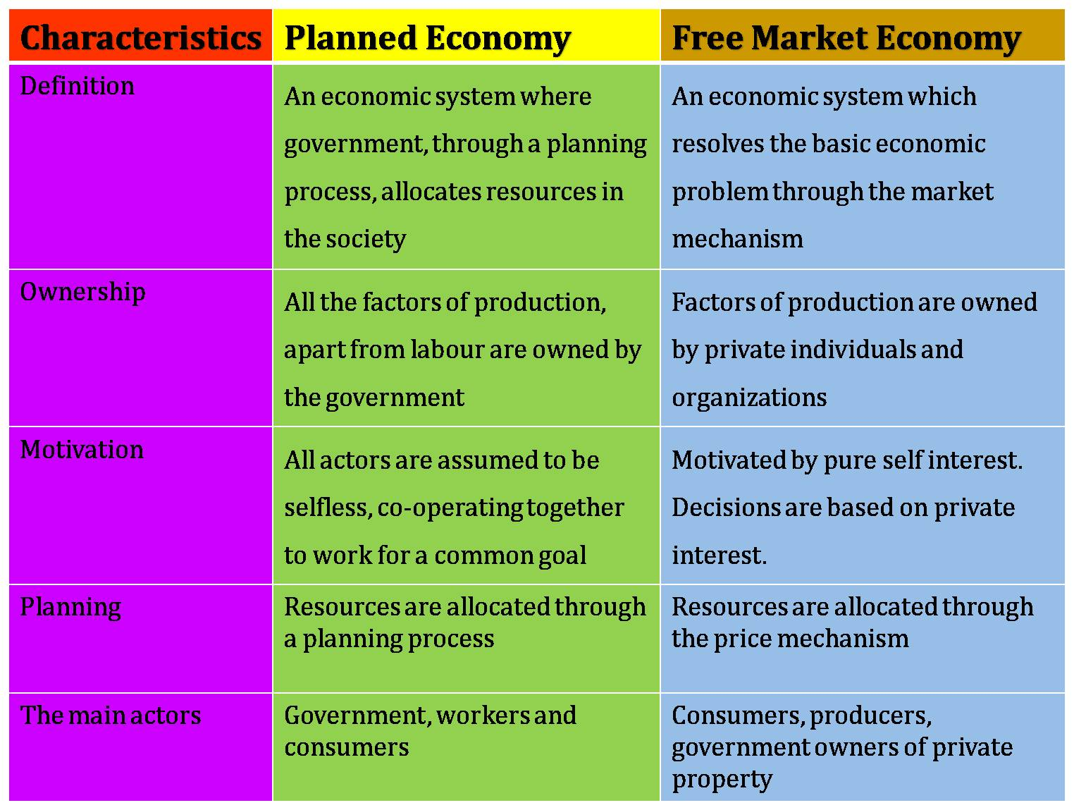
IT3090 - Business Management for IT- Lecture 04 - Ms. Nilmini Rathnayake

Slide 12
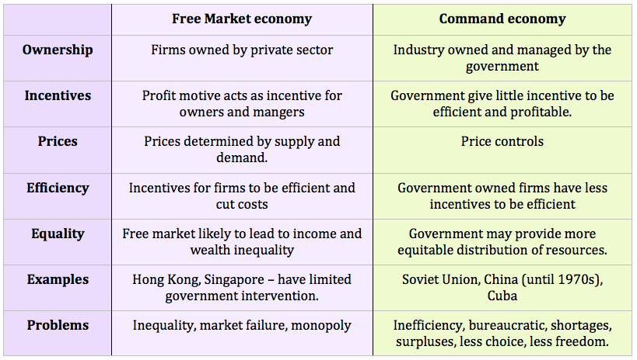
IT3090 - Business Management for IT- Lecture 04 - Ms. Nilmini Rathnayake

Slide 13
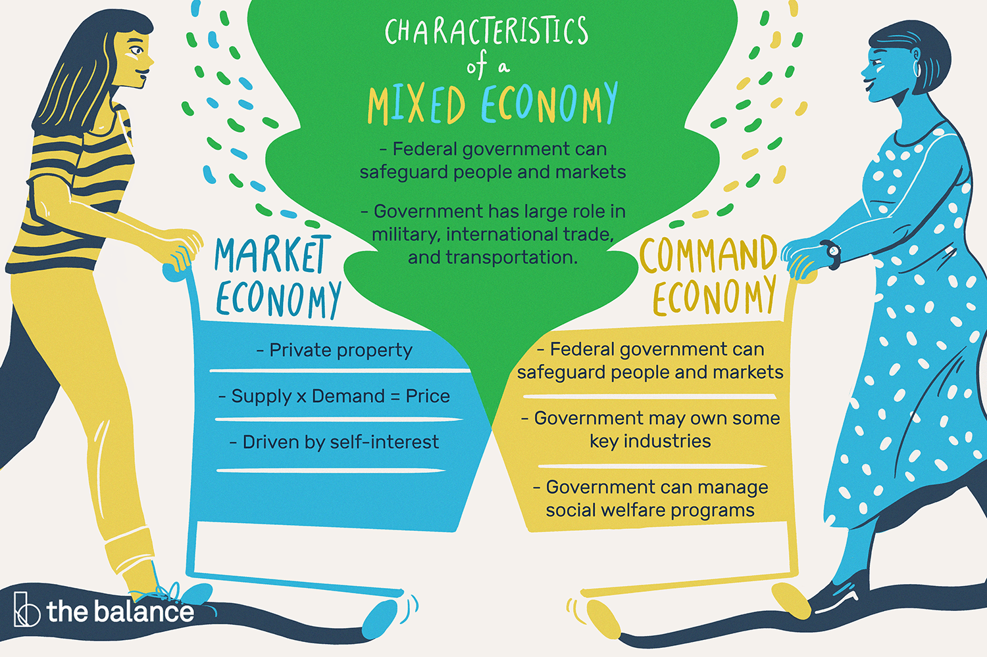
IT3090 - Business Management for IT- Lecture 04 - Ms. Nilmini Rathnayake

Slide 14
Thank You
IT3090 - Business Management for IT- Lecture 04 - Ms. Nilmini Rathnayake

